Slide 1
ARS – Service Documentation
Aircraft Reservation Service

Slide 2
Requirements
Java JDK 8
JBoss Wildfly 8.0
JPA 2.0 compliant Database
(tested with MySQL)

Slide 3
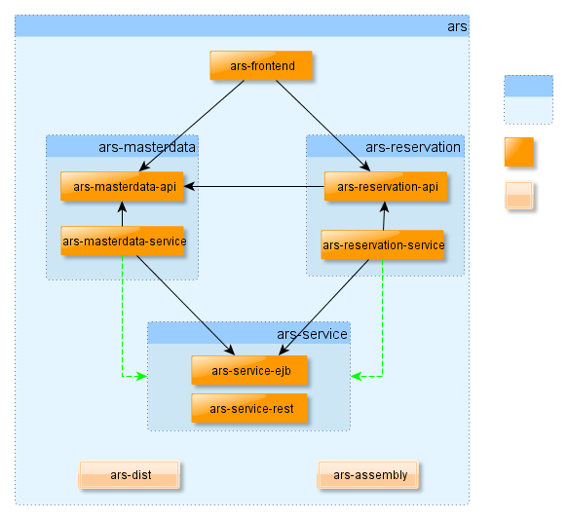
Maven Module Structure
POM Package
Jar/WAR Package
„Assembly“ Package
Dependency
Parent POM

Slide 4
Naming Convention
Base Package Prefix: com.prodyna.pac
each POM Project appends sub-package:
com.prodyna.pac.ars (Root Project POM)
com.prodyna.pac.ars.frontend
and so forth …
Project Names are aligned to parent POM Path
Eg: ars-masterdata-api
Parent: -> ars-masterdata -> ars

Slide 5
Naming Convention
Public Module Name Suffix: -api
Impl. Module Name Suffix: -service
CRUD Service Interface: [Entity]Service
CRUD Service Impl: [Entity]ServiceBean
Subclasses should refine Name of super class
RestExceptionMapper as subclass of ExceptionMapper

Slide 6
Module Dependency
ars-[section]-api must not depend on ars-[section]-service module
Between 2 sections, only dependencies to an –api module are allowed
2 „service“ modules must depend on each other
Common code to be used in all EJB implementation must be in ars-service-ejb

Slide 7
Misc Conventions
No Queries in SourceCode
Only NamedQuery defined in Model Object
Use Annotation where possible (JPA, Validation, Injection, Authorization …)
Care about correct http Status Codes: 200, 401, 500 (use appriate Codes for errors – not Message in body)

Slide 8
Validation
Use Bean Validation Annotation where possible
For runtime validation:
com.prodyna.pac.ars.service.ejb.Validator<T>
create Service Decorator with CDI and inject Validator impl in Decoration
Intercept call and throw IllegalArgumentException in case parameter is not valid

Slide 9
Frontent Conventions
Use FXML where possible
Avoid creating/modifying Scene on Code
Allign Code to the current Design
Access backend Service using DynamicProxy
ServiceProxyFactory

